Slide 1
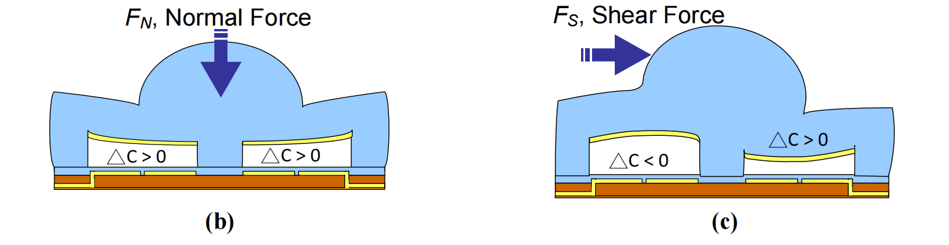
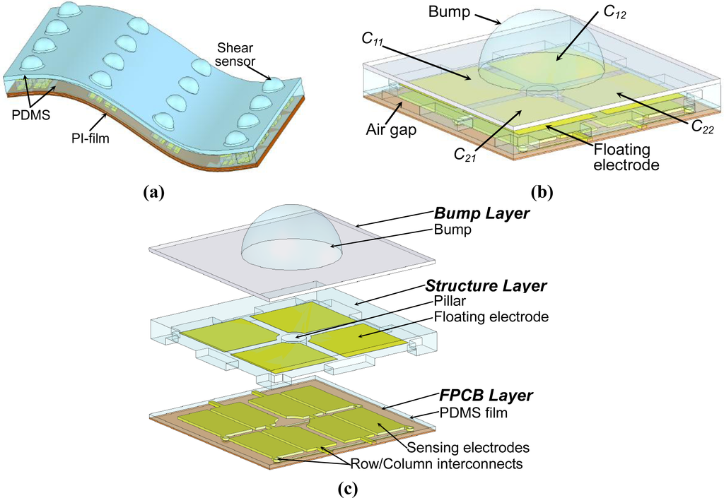
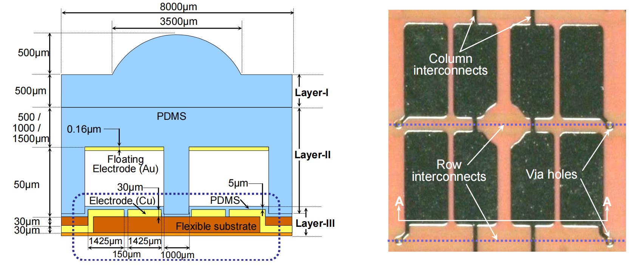
Interesting Design

Slide 2
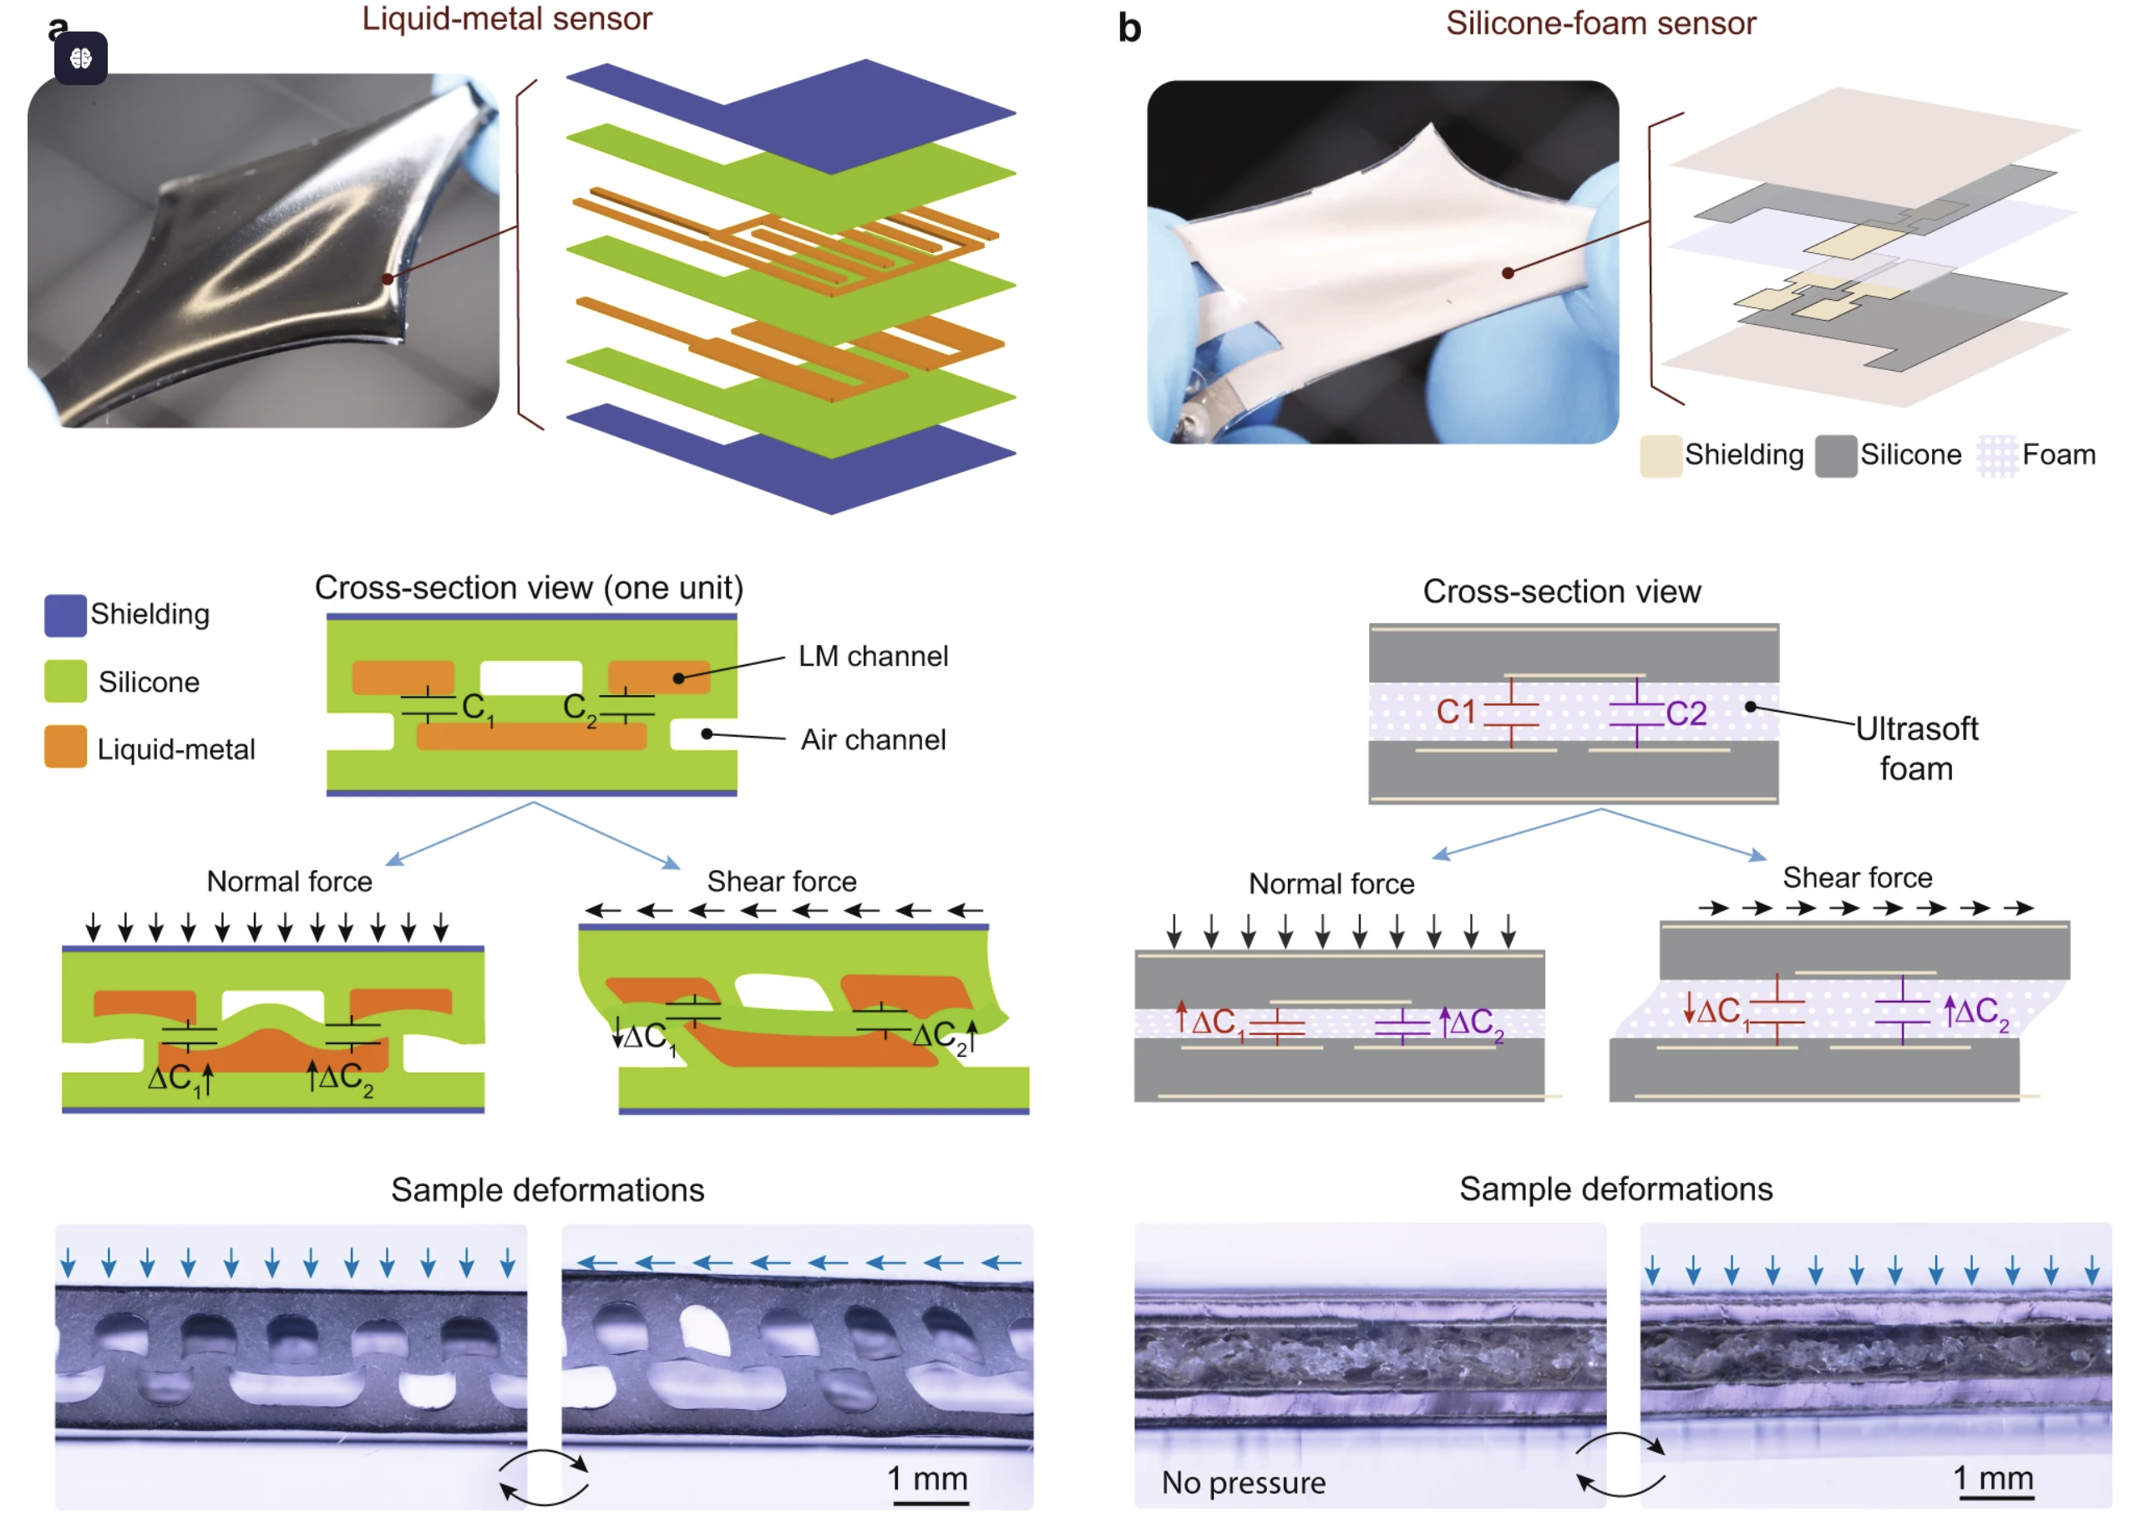
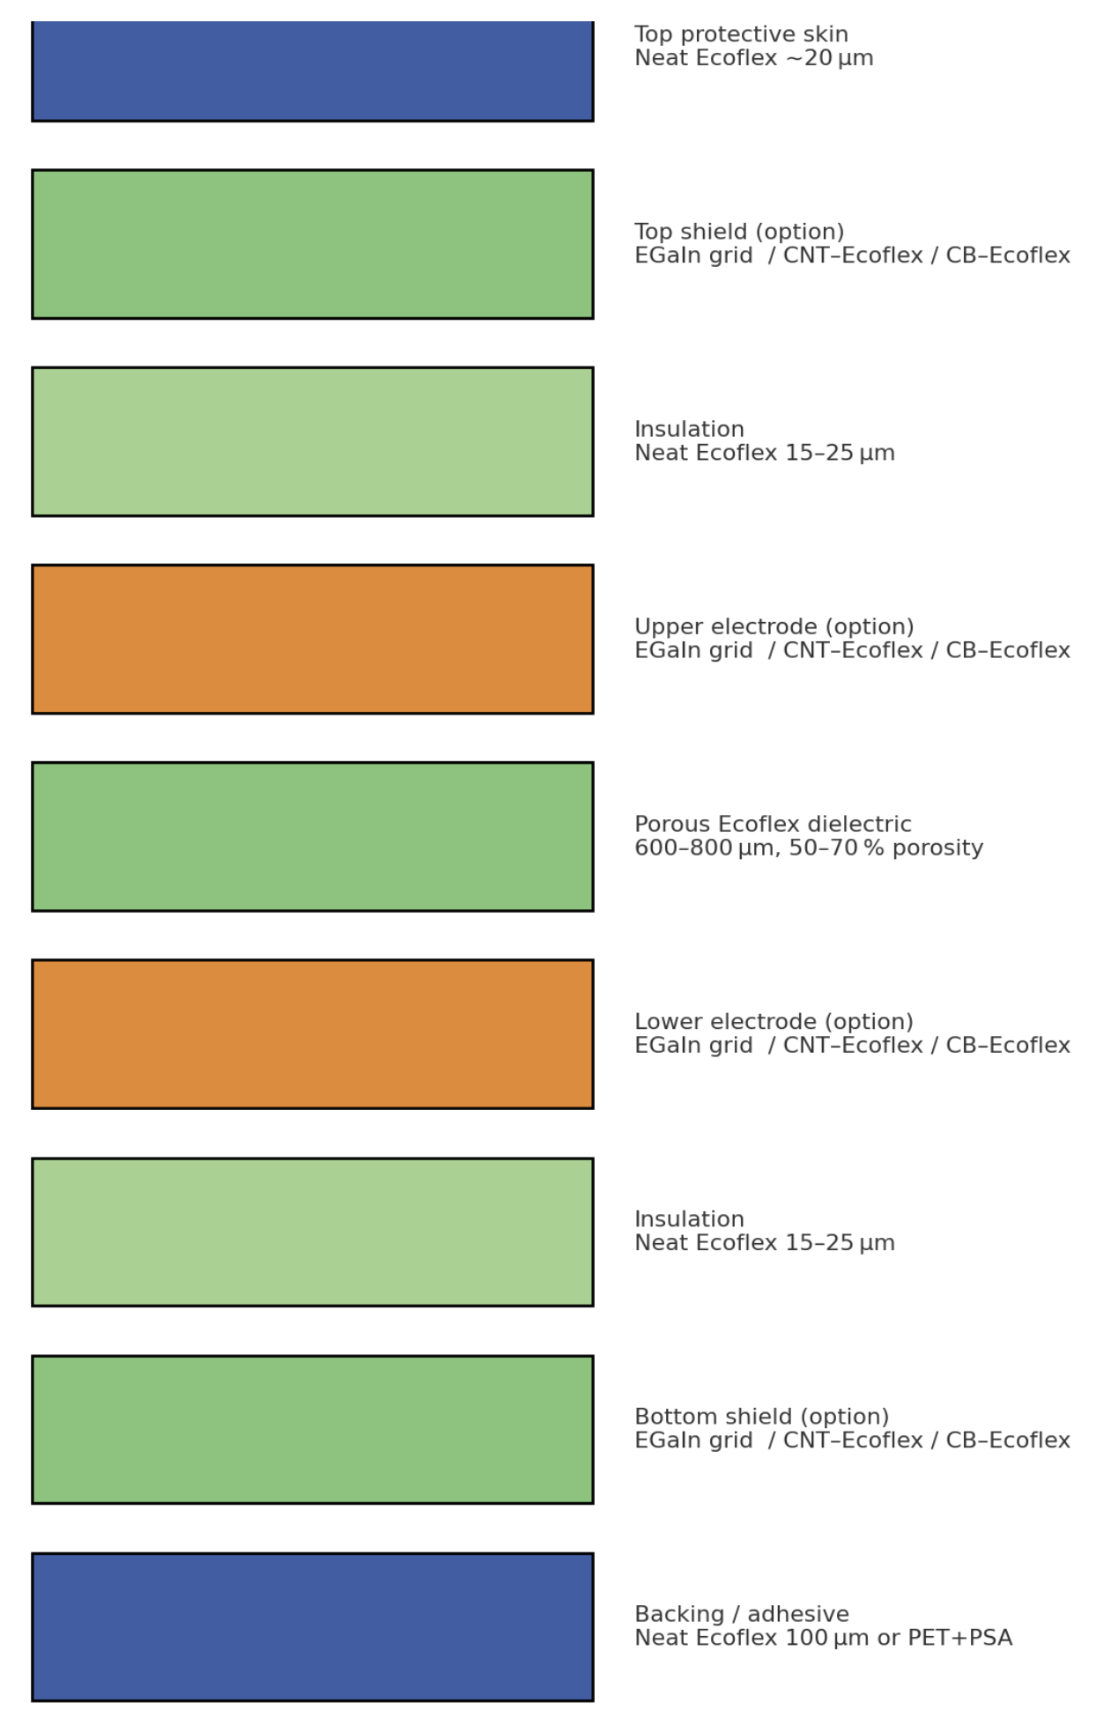
# | layer | thick | material
1 | Top protective skin | 15 – 25 µm | neat Ecoflex 00-30
2 | Top shield | 25 – 80 µm | silicone matrix
3 | Upper insulation | 15 – 25 µm | neat Ecoflex
4 | Upper electrode | 25 – 80 µm | silicone matrix
5 | Porous dielectric | 0.6 – 0.8 mm | sugar-templated porous Ecoflex
6 | Lower electrode | 25 – 80 µm | silicone matrix
7 | Lower insulation | 15 – 25 µm | neat Ecoflex
8 | Bottom shield | 25 – 80 µm | silicone matrix
9 | Backing / adhesive | 80 – 150 µm | neat Ecoflex or PET 50 µm + silicone PSA
silicone matrix
EGaIn grid (25 µm)
CNT/Ecoflex (6 wt %, 60 µm)
CB/Ecoflex (4 wt %, 80 µm)

Slide 3
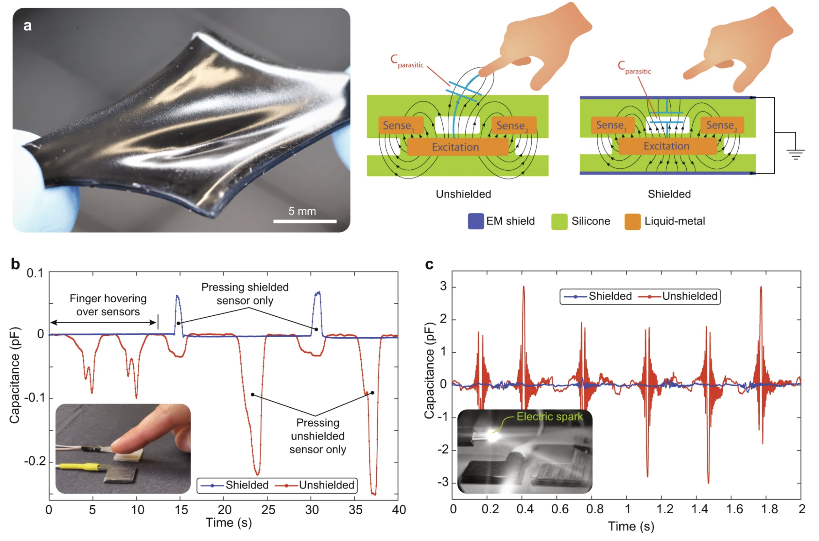
Shield Layer
Shielded soft force sensors
a significant parasitic capacitance will be generated when approaching the human hand, affecting the measurement of force

Slide 4
Shield&Conductive Material
EGaIn liquid‑metal grid (spray‑stencil) CNT/Ecoflex composite CB/Ecoflex composite
Shielding medium | Shielding effectiveness SE*(dB @ 1 GHz) | Sheet resistance Rs(Ω ⁻¹) | Max. tensile strain ε-max(%) | Thickness(µm) | Required tools / process
Ag-coated knit fabric (Shieldex SF) | 40 – 95 | 0.1 – 1 | 10 – 15 | 80 – 150 | Scissors + fabric glue
CB/Ecoflex composite (10 wt %) | 20 – 30 | 5 k – 30 k | > 200 | 40 – 200 | Planetary mixer + blade
EGaIn liquid-metal grid (spray-stencil) | 70 – 85 | < 0.05 | > 200 | 25 (+ 20 µm encaps.) | Airbrush + HCl mist
Ink-jet / screen-printed Ag-NP ink | 40 – 60 | 0.02 – 0.1 | 3 – 5† | 8 – 15 | Desktop ink-jet + 80 °C cure
CNT/Ecoflex composite | 25 – 40 | 0.3 k – 3 k | 150 | 40 – 150 | Tip sonicator + blade

Slide 5
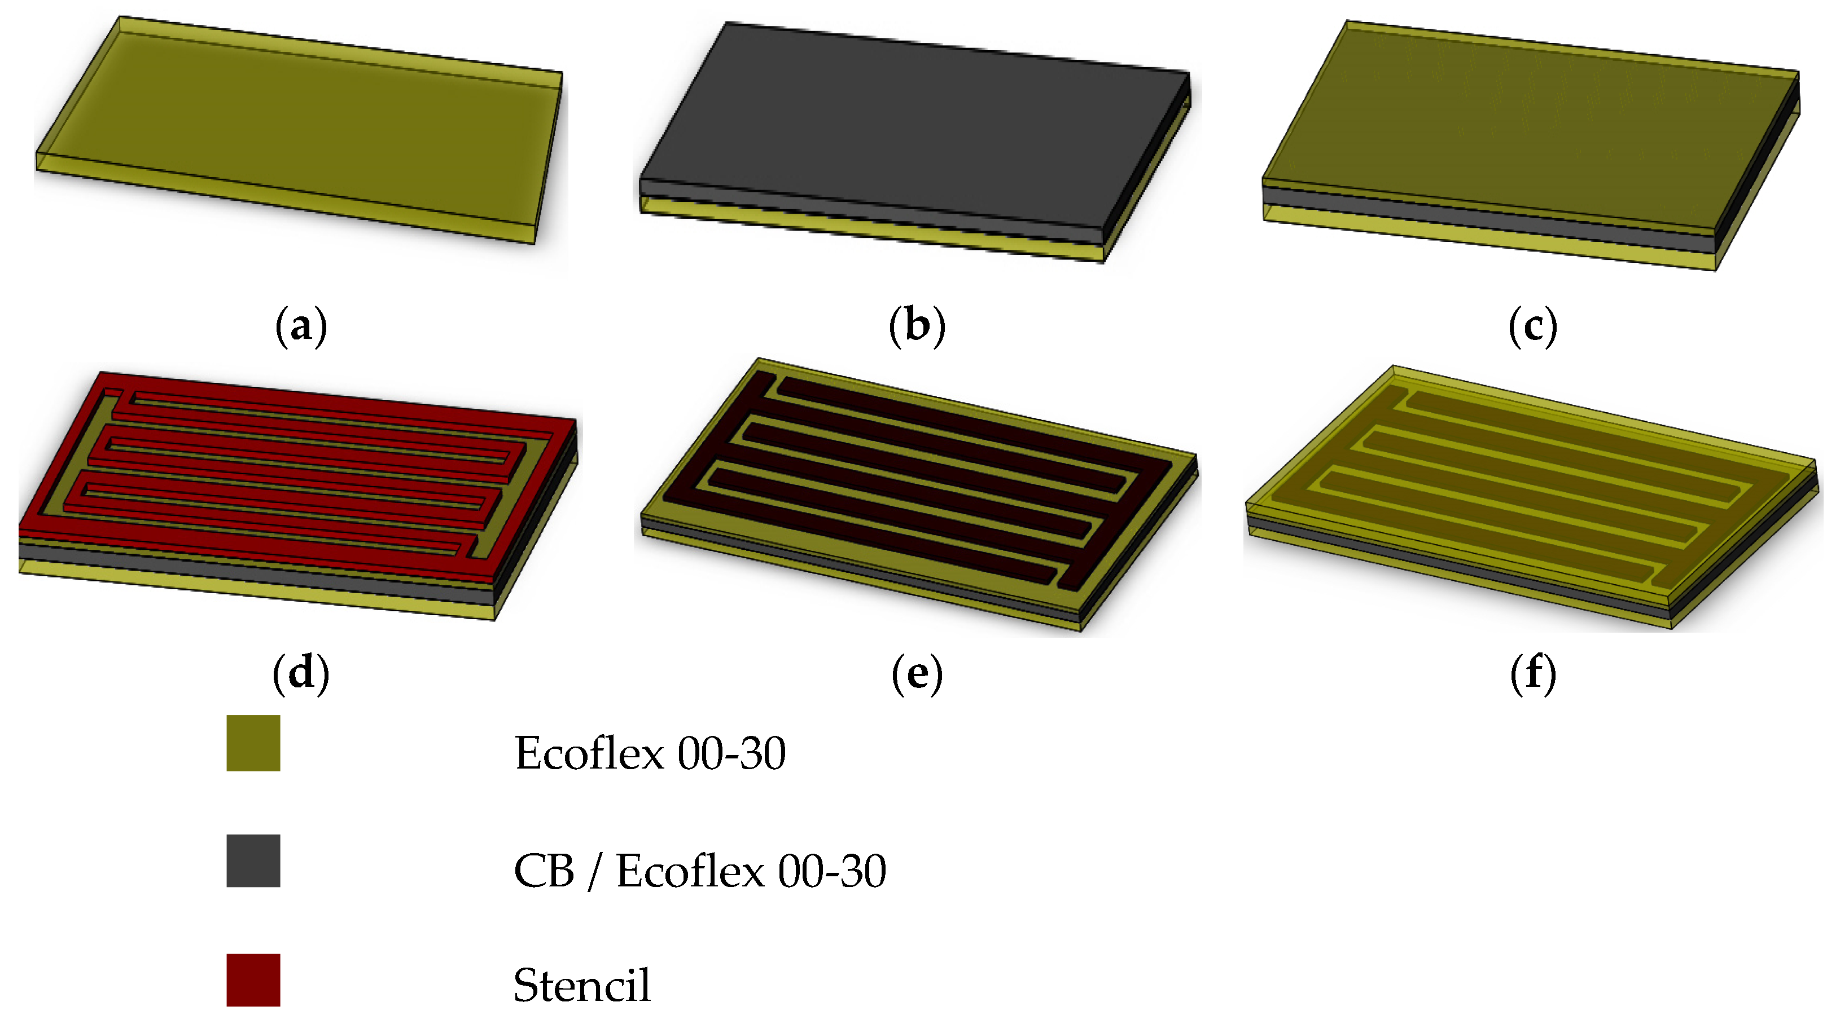
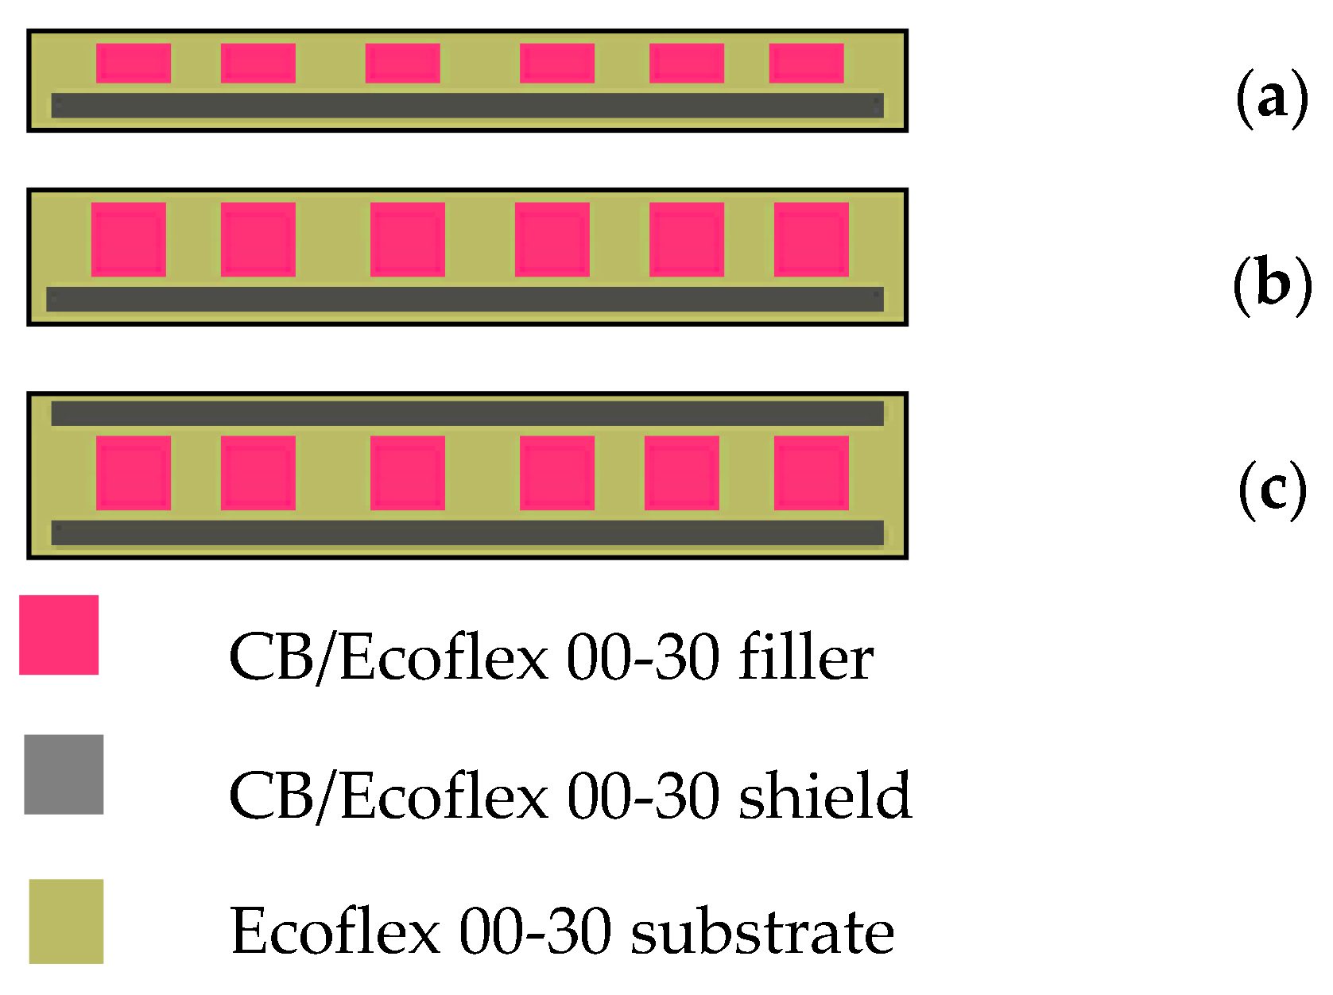
CB/Ecoflex
Multi-Layered Carbon-Black/Elastomer-Composite-Based Shielded Stretchable Capacitive Sensors for the Underactuated Robotic Hand

Slide 6
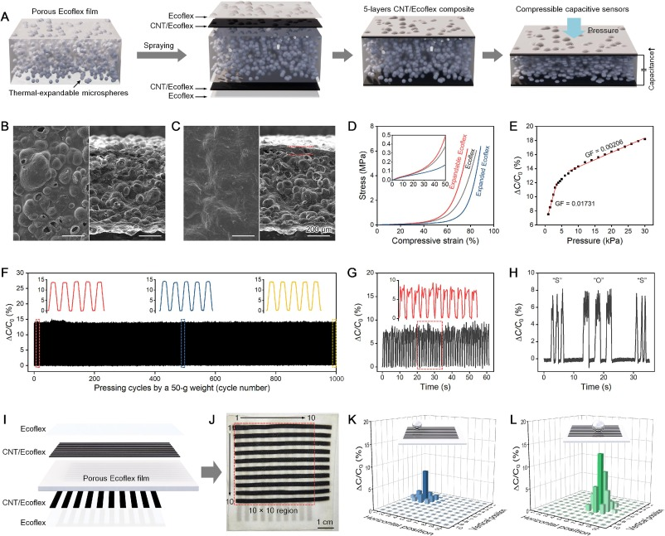
Stretchable carbon nanotube/Ecoflex conductive elastomer films toward multifunctional wearable electronics
CNT/Ecoflex composite
https://www.sciencedirect.com/science/article/pii/S1385894724090259

Slide 7
Material | Sheet-R (Ω ⁻¹) | ε_max | EMI SE @ 1 GHz | noise (16 bit CDC)
EGaIn grid | < 0.05 | > 200 % | 70 – 85 dB | < 0.1 fF
CNT/Ecoflex | 1 – 5 kΩ | ≈ 150 % | 25 – 40 dB | 0.5 fF
CB/Ecoflex | 5 – 30 kΩ | ≈ 200 % | 20 – 30 dB | 1 – 2 fF

Slide 8
Electrode Design

Slide 9
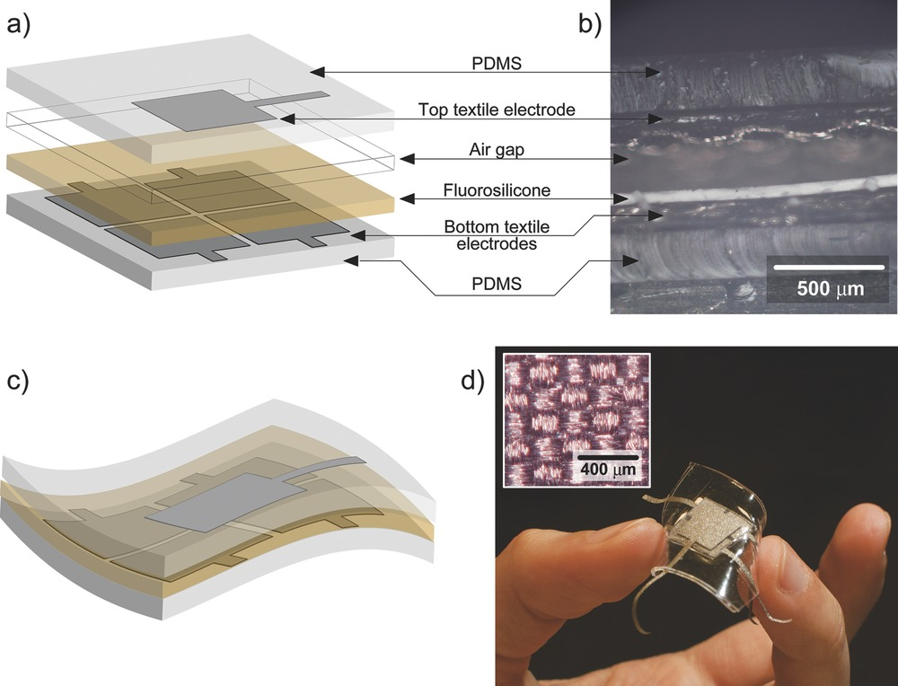
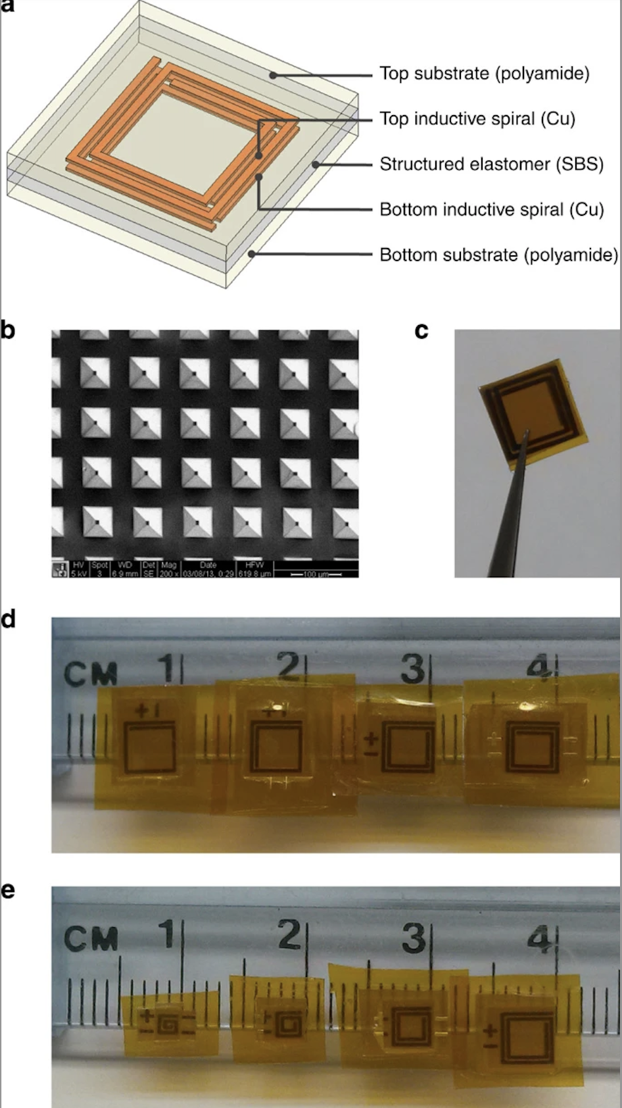

Slide 10
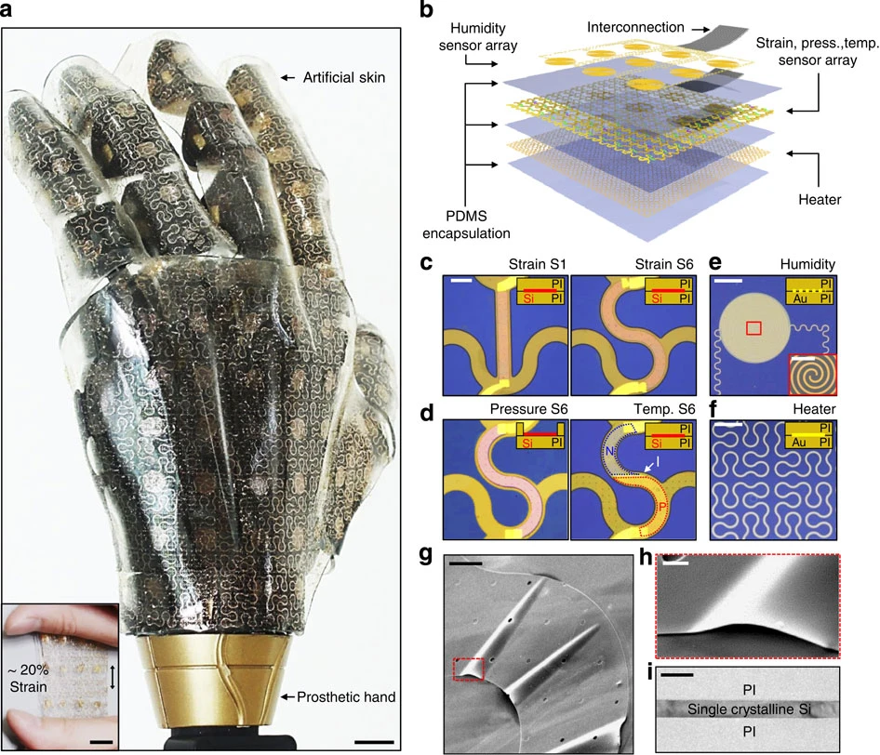
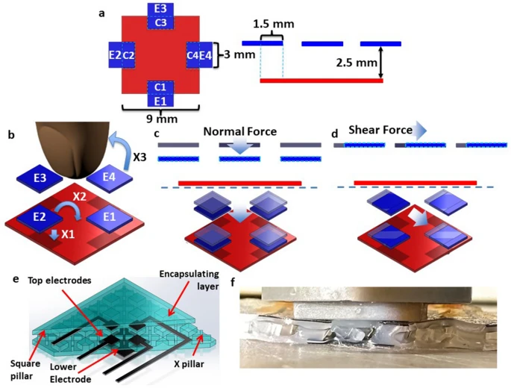
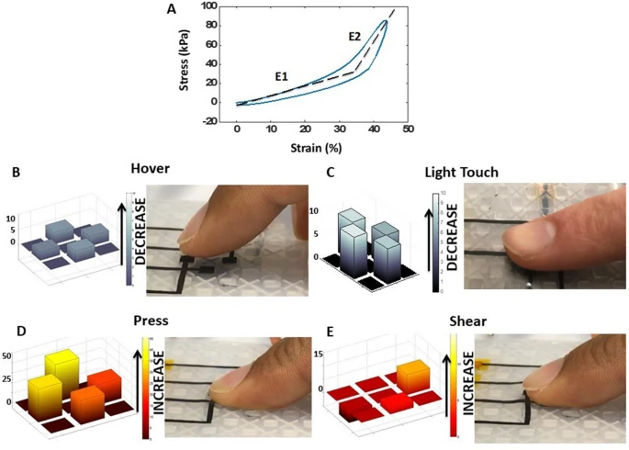

Slide 11
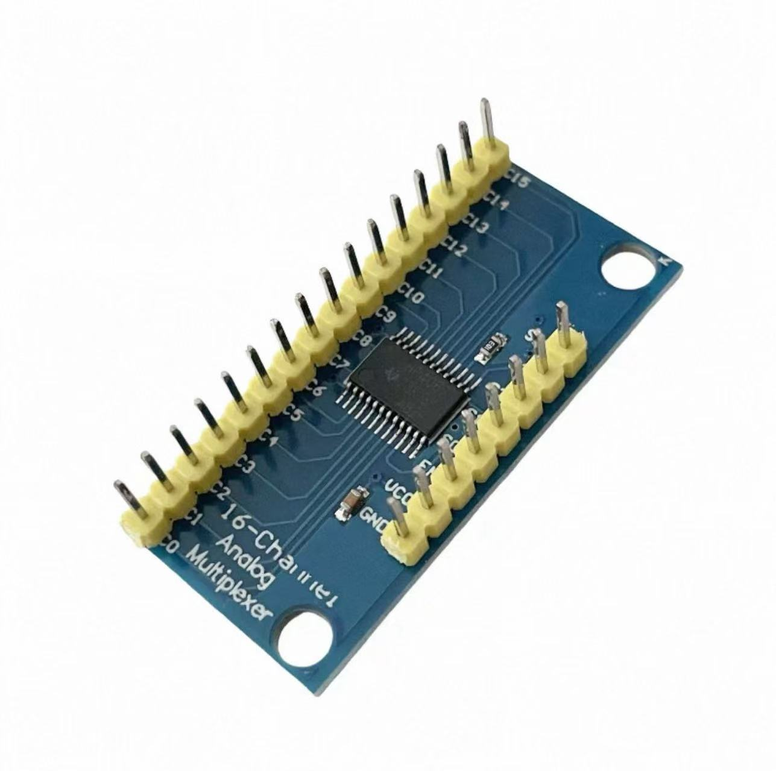
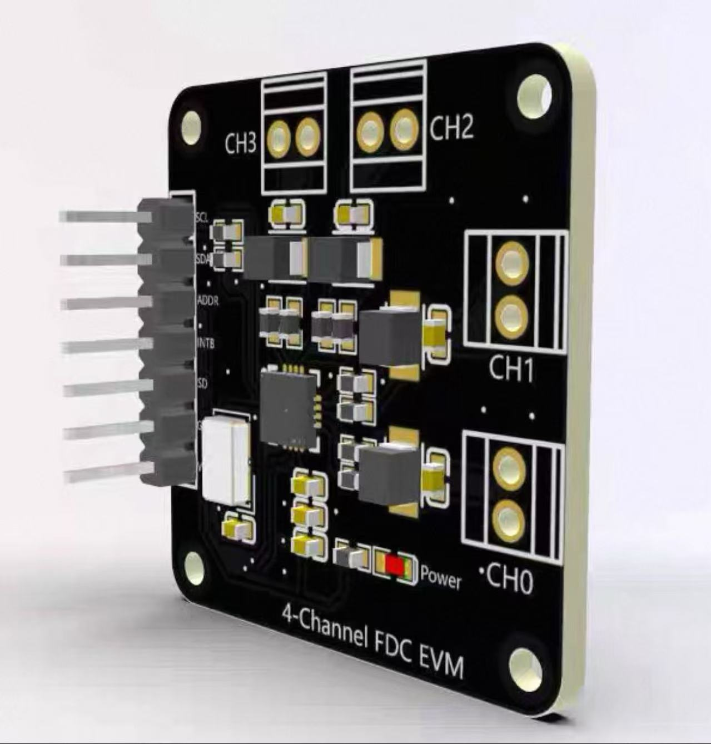
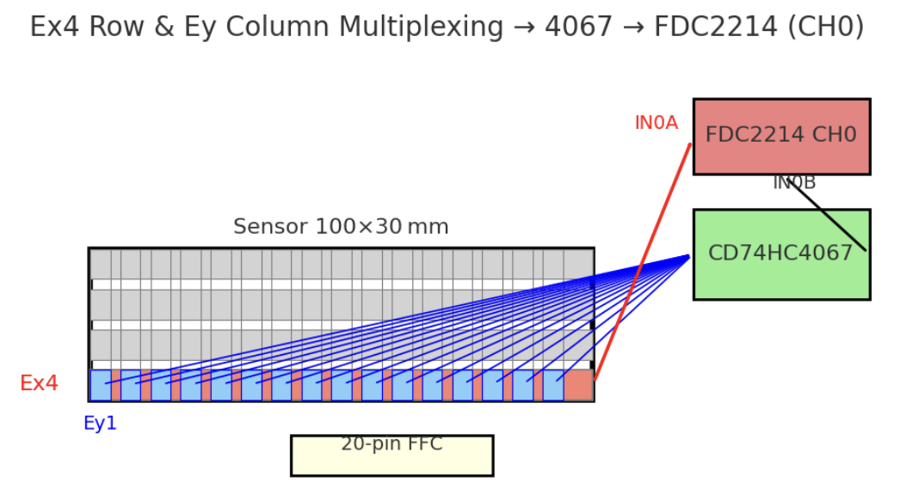
16-1 CD74HC4067 Multiplexer
4 channel FDC2214

Slide 12
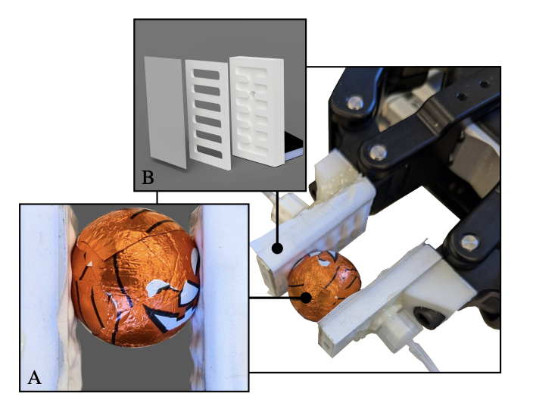
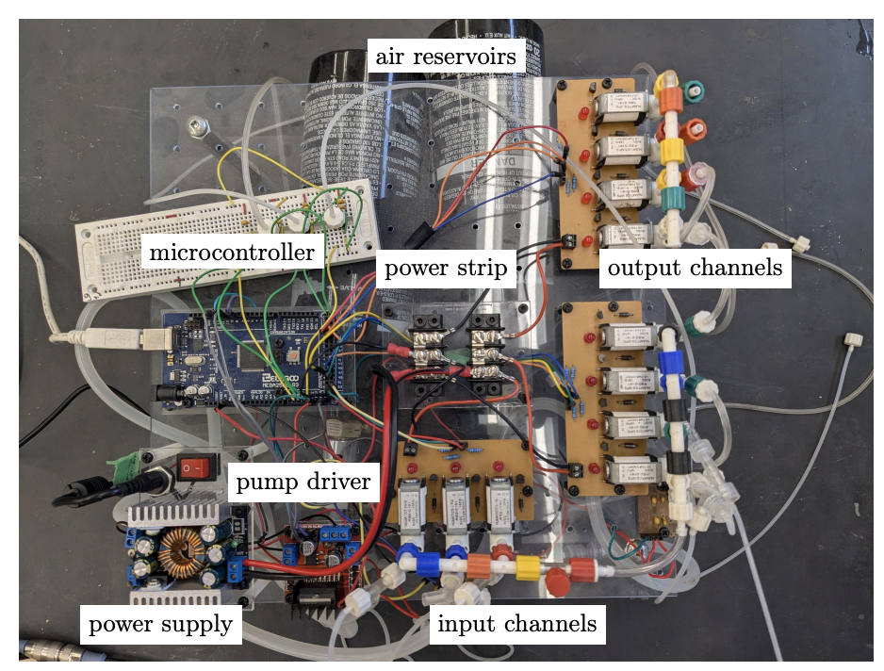
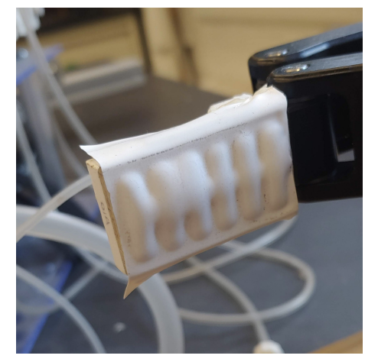
Inflatable small airbags that can protrude using an air pump

Slide 13
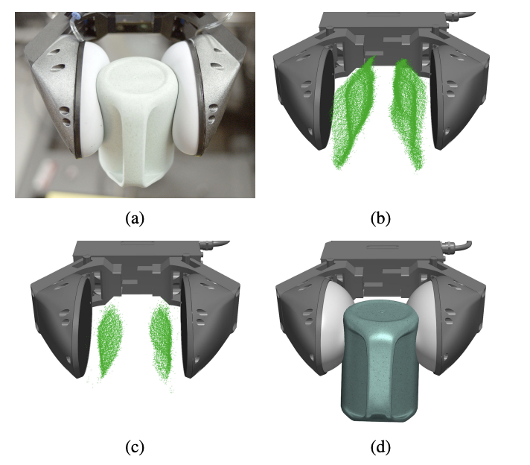
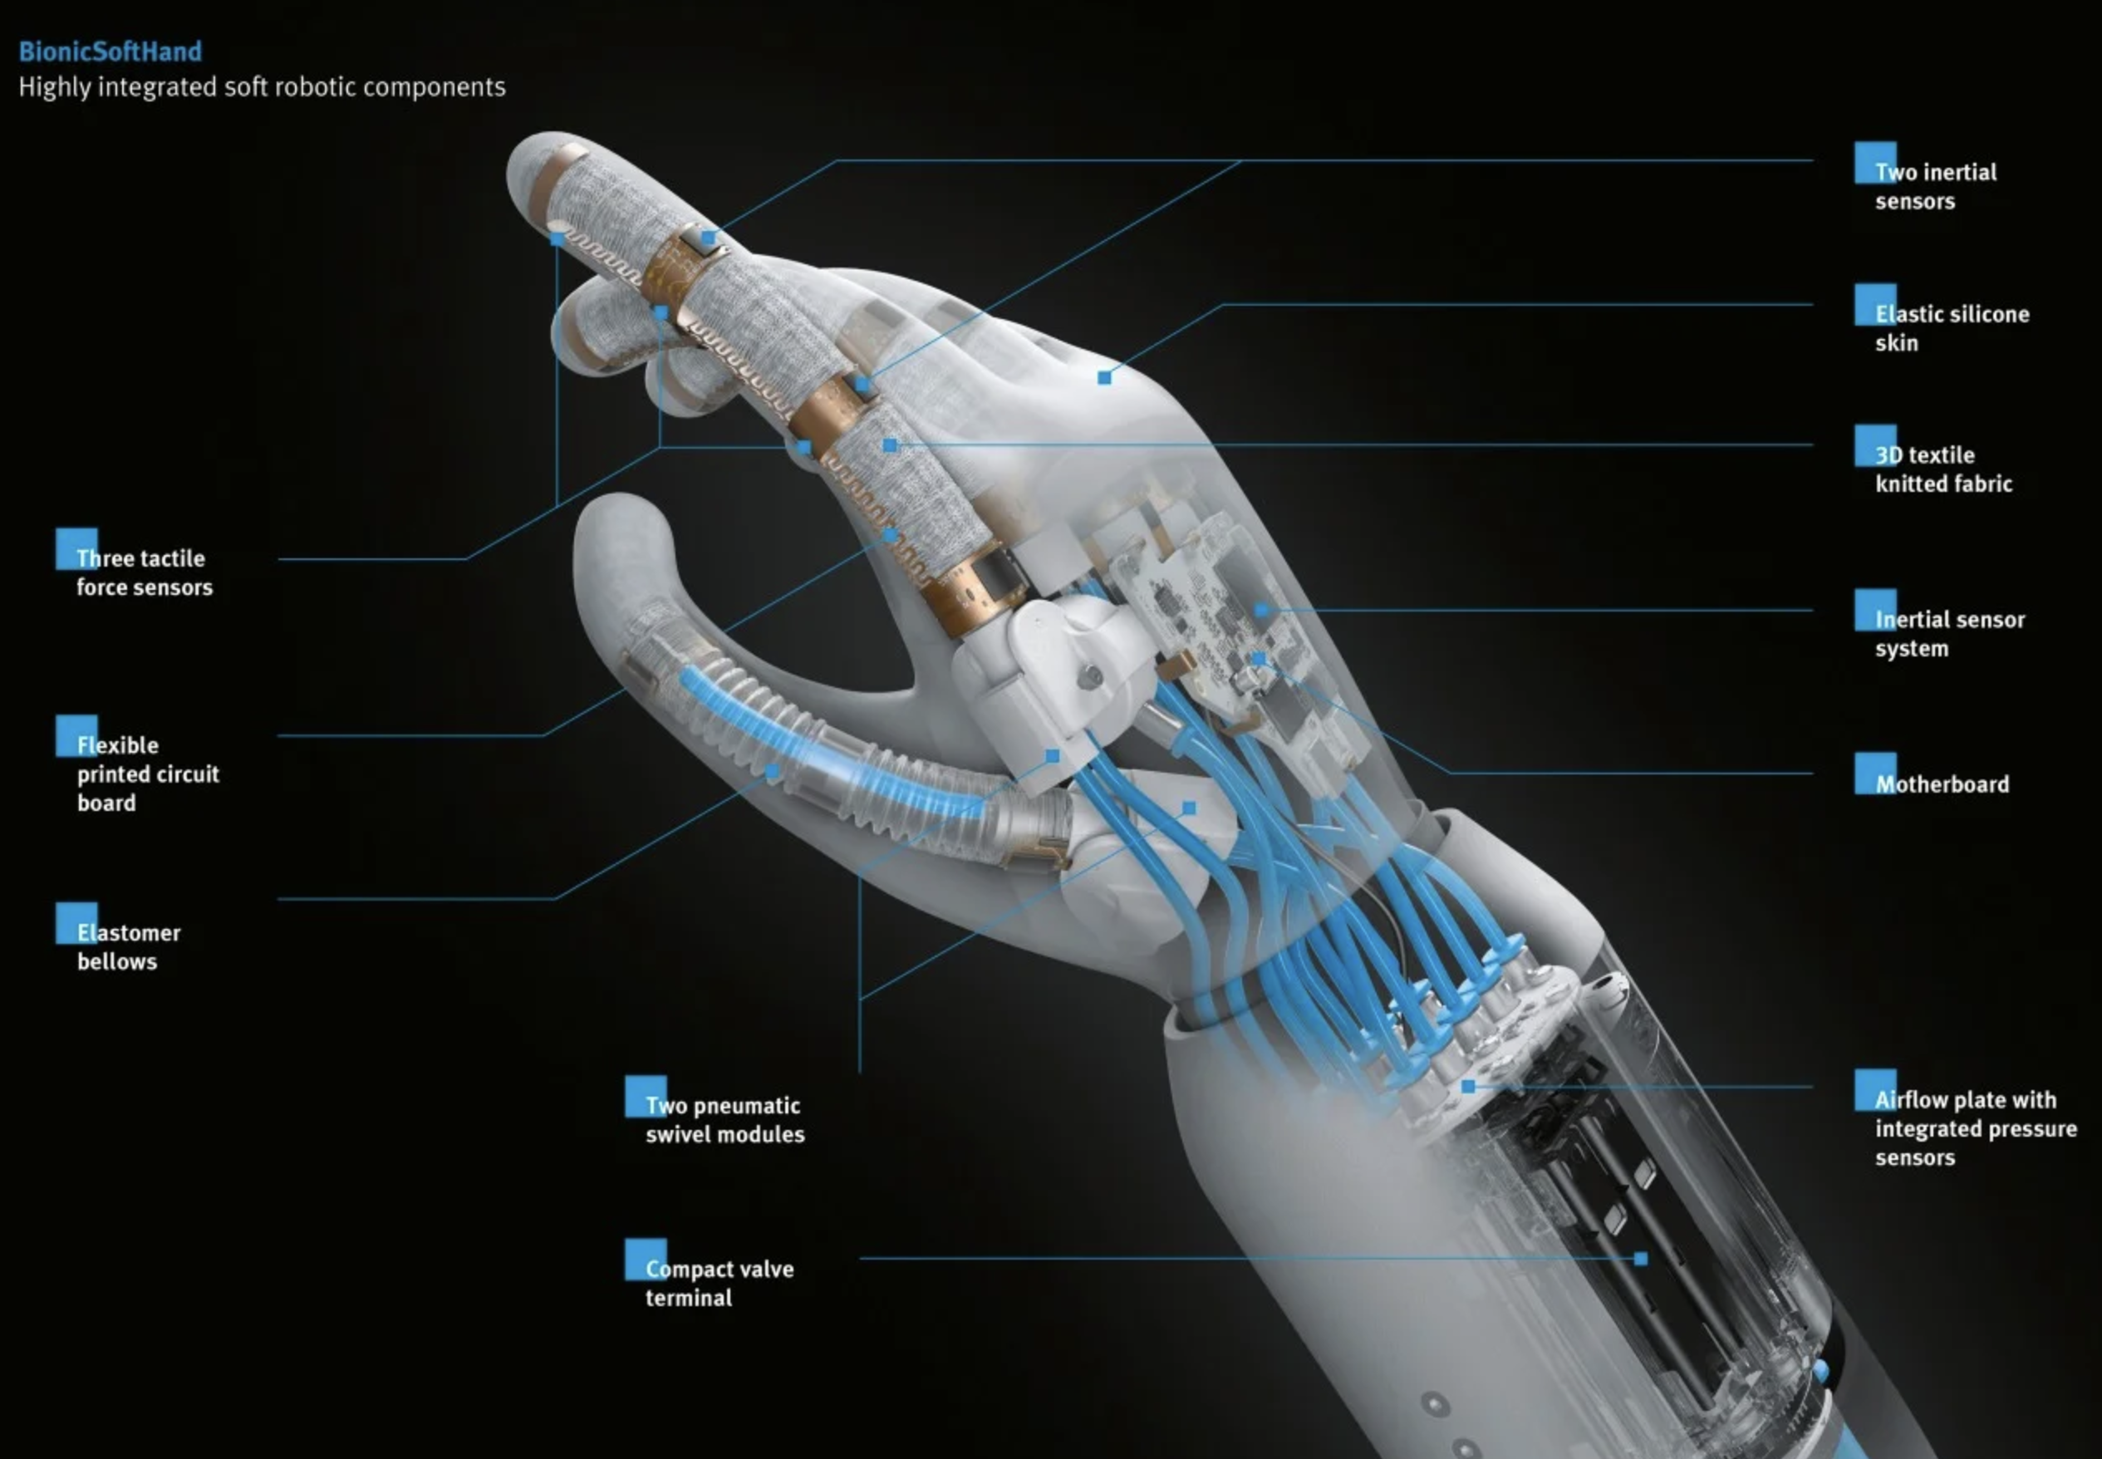
Festo Pneumatic robot hand with artificial intelligence

